Slide 1

Aspiring Data Analyst
E-COMMERCE SALES & CUSTOMER ANALYTICS
MySQL Data Analyst Portfolio Project
Sahil Kanojia
Portfolio Project

Slide 2

Scope & Objectives
E-Commerce Sales & Customer Analytics Portfolio Project by Sahil Kanojia
A structured MySQL-based analytical project covering database design, customer and product analysis, business insight extraction, and reusable reporting views.
PROJECT
OVERVIEW
• Designed relational e-commerce database using MySQL
• Analyzed customers, products, orders & payments
• SQL for business insights extraction
• Built reusable analytical views for reporting
SQL used to extract meaningful business insights from relational e-commerce data across customers, products, orders, and payments.

Slide 3

Five strategic goals guiding this e-commerce analytics portfolio project.
01 Measure overall sales performance
02 Identify top customers and products
03 Analyze category & department performance
04 Understand payment and order behavior
05 Support data-driven business decisions
Each objective is addressed through targeted SQL queries, analytical views, and structured data modeling — delivering actionable insights from raw e-commerce data.
BUSINESS OBJECTIVES

Slide 4

500
Customers
50
Categories
1,000
Products
A comprehensive relational e-commerce database built in MySQL — designed to simulate real-world sales, customer, and product analytics at scale.
DATASET
AT A GLANCE
5,000
Orders
15,000
Order Items
5,000
Payments
Each metric represents a core table in the relational schema — powering 20+ analytical SQL queries and reusable reporting views.

Slide 5
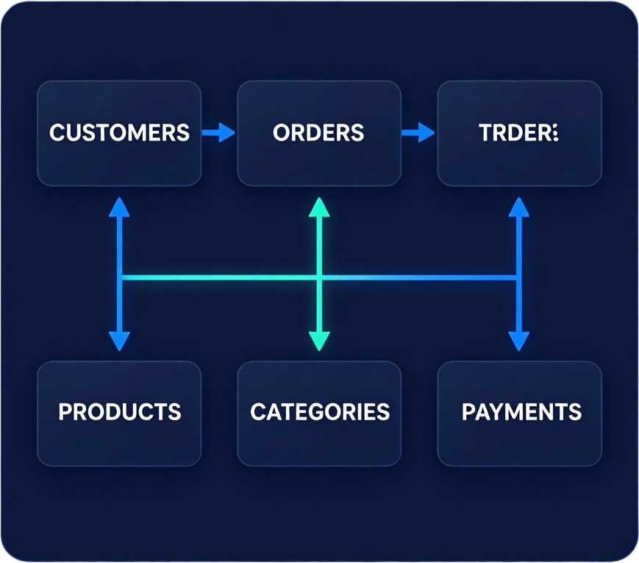
CUSTOMERS
customer_id (PK)
customer_name
email, city, state
ORDERS
order_id (PK)
customer_id (FK)
order_date, status
Six relational tables form the core of this e-commerce data model, connected by primary and foreign key relationships to enable powerful cross-table analytics.
DATABASE ARCHITECTURE
ORDER_ITEMS
PRODUCTS
CATEGORIES
PAYMENTS
CUSTOMERS → ORDERS → ORDER_ITEMS → PRODUCTS → CATEGORIES
ORDERS → PAYMENTS
Blue lines: primary flow | Teal lines: payment branch

Slide 6
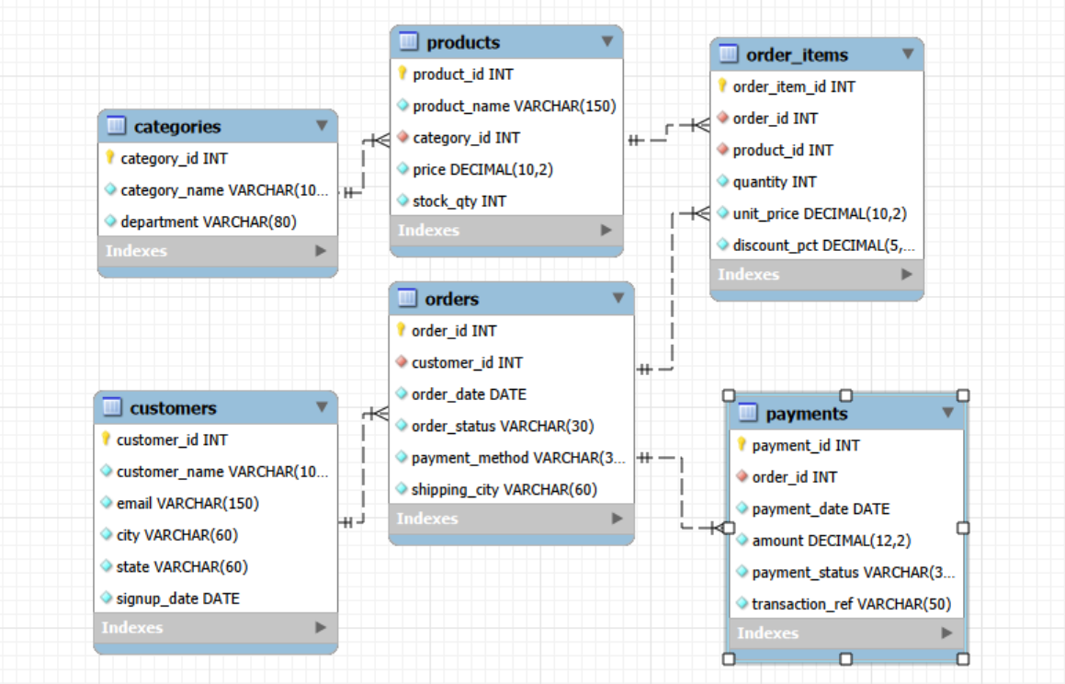
Visual representation of the relational database schema. Replace the placeholder below with the actual MySQL Workbench ER Diagram screenshot.
ENTITY RELATIONSHIP DIAGRAM
Tables: CUSTOMERS · ORDERS · ORDER_ITEMS
PRODUCTS · CATEGORIES · PAYMENTS
Source: MySQL Workbench Schema Designer

Slide 7

Core Techniques
─────────────
SELECT • JOIN
GROUP BY • HAVING
Aggregate Functions
CASE Statements
A comprehensive set of SQL techniques was applied throughout this project to extract, transform, and analyze e-commerce data — from basic queries to advanced window functions and reusable views.
SQL
TECHNIQUES
USED
Advanced Techniques:
CTE (Common Table Expressions)
Window Functions
DENSE_RANK • ROW_NUMBER
Subqueries • Views
Window functions like DENSE_RANK() and ROW_NUMBER() enable advanced ranking and segmentation. CTEs improve query modularity and readability. Reusable views streamline repeated analytical queries across the project.

Slide 8

Critical questions this project answers using SQL analytics and reusable views.
❶ What is the total revenue generated?
❷ Which products generate the highest revenue?
❸ Which categories perform best overall?
❹ Who are the highest-value customers?
❺ Which cities generate the most revenue?
❻ What is the monthly revenue trend?
❼ Which payment methods perform best?
❽ Which products are low in stock?
❾ Which customers place the most orders?
❿ How do discounts affect sales volume?
KEY BUSINESS
QUESTIONS

Slide 9
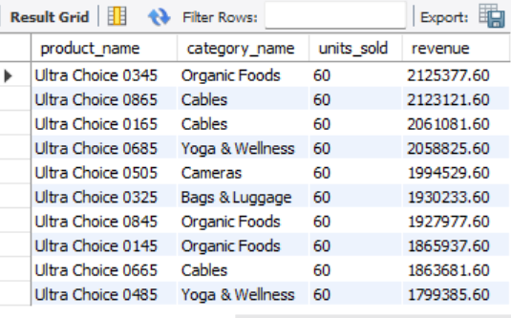
QUERY 1
• ORDER BY revenue DESC • LIMIT 10
TOP 10 PRODUCTS
BY REVENUE USING ANALYTICAL VIEW
SELECT product_id,
product_name,
category_name,
department,
total_revenue,
total_units_sold,
total_orders
FROM vw_product_performance
ORDER BY total_revenue DESC
LIMIT 10;
Business Insight: Identifies the highest revenue-generating products — critical for inventory prioritization, marketing focus, and strategic product decisions.

Slide 10
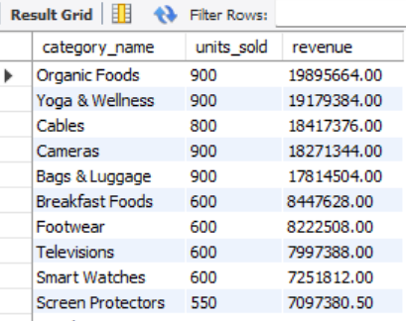
QUERY 2
• JOIN + GROUP BY
REVENUE BY
CATEGORY
SELECT
c.category_name,
c.department,
COUNT(DISTINCT o.order_id)
AS totaSUM(oi.quantity)
l_orders,
AS units_sold,
ROUND(SUM(
oi.quantity * oi.unit_price
* (1 - oi.discount_pct/100)
), 2) AS total_revenue
FROM order_items oi
JOIN products p
ON oi.product_id = p.product_id
JOIN categories c
ON p.category_id = c.category_id
JOIN orders o
ON oi.order_id = o.order_id
WHERE o.order_status
!= 'Cancelled'
GROUP BY
c.category_name,
c.department
ORDER BY
total_revenue DESC;
💡 Business Insight: Highlights best-performing product categories driving the most sales revenue — enabling focused inventory, marketing, and budget allocation by category and department.

Slide 11
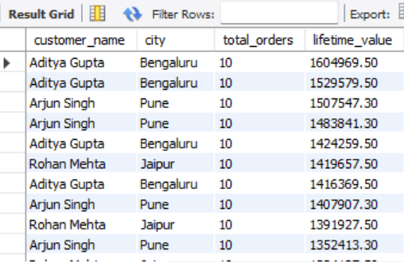
QUERY 3
SQL Query using vw_customer_value analytical view — ranked by total lifetime spend, descending order, limited to top 20 high-value customers.
TOP 20 CUSTOMERS
BY LIFETIME
VALUE
SELECT customer_id,
customer_name,
total_orders,
lifetime_value
FROM vw_customer_value
ORDER BY lifetime_value DESC
LIMIT 20;
Business Insight: Pinpoints the most valuable customers for targeted retention strategies
Uses reusable analytical view: vw_customer_value
Ranked by lifetime value (total spend per customer)
Supports loyalty programs and VIP customer segmentation

Slide 12
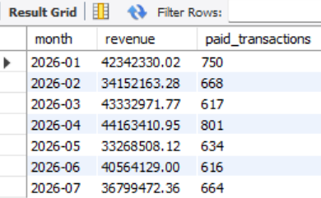
QUERY 4
Techniques: DATE_FORMAT()
Aggregation: SUM(), COUNT()
Filtering: WHERE, order_status
Grouping: GROUP BY month
Sorting: ORDER BY ASC
MONTHLY REVENUE TREND
SELECT DATE_FORMAT(o.order_date, '%Y-%m') AS revenue_month,
COUNT(DISTINCT o.order_id) AS total_orders,
SUM(oi.quantity * oi.unit_price * (1 - oi.discount_pct/100)) AS monthly_revenue
FROM orders o
JOIN order_items oi ON o.order_id = oi.order_id
WHERE o.order_status != 'Cancelled'
GROUP BY revenue_month
ORDER BY revenue_month ASC;
Business Insight:
Reveals sales seasonality and monthly growth trends. Helps identify peak revenue months and low-performing periods for strategic planning.

Slide 13
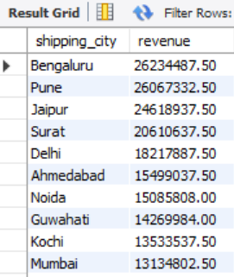
QUERY 5
SQL with JOIN, CASE, GROUP BY — Geographic Revenue Distribution
REVENUE
BY CITY
SELECT
o.shipping_city,
CASE
WHEN o.shipping_city
IN ('Mumbai','Delhi',
'Bangalore')
THEN 'Metro'
ELSE 'Non-Metro'
END AS city_tier,
COUNT(DISTINCT o.order_id)
AS total_orders,
SUM(oi.quantity
* oi.unit_price
* (1 - oi.discount_pct))
AS total_revenue
FROM orders o
JOIN order_items oi
ON o.order_id
= oi.order_id
GROUP BY
o.shipping_city,
city_tier
ORDER BY
total_revenue DESC;
📍 Business Insight: Reveals geographic revenue distribution across cities and tiers — enabling targeted regional marketing and resource allocation strategies.

Slide 14
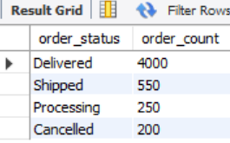
QUERY 6
SQL: GROUP BY and COUNT on order_status
ORDER STATUS
DISTRIBUTION
SELECT order_status,
COUNT() AS total_orders,
ROUND(COUNT() * 100.0 /
SUM(COUNT(*))
OVER(), 2)
AS pct_share
FROM orders
GROUP BY order_status
ORDER BY total_orders DESC;
Business Insight: Provides insight into fulfillment pipeline health — identifying the share of Delivered, Pending, Cancelled, and Refunded orders to monitor operational performance.

Slide 15
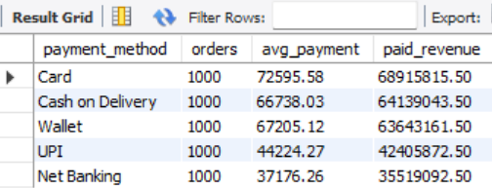
QUERY 7
SQL Techniques Used
• JOIN (orders → payments)
• SUM() & AVG() aggregation
• CASE for revenue tier classification
• GROUP BY payment method
PAYMENT METHOD PERFORMANCE
SELECT p.payment_method,
COUNT(p.payment_id) AS total_transactions,
SUM(py.amount) AS total_revenue,
AVG(py.amount) AS avg_payment_value,
CASE
WHEN SUM(py.amount) > 500000 THEN 'High'
WHEN SUM(py.amount) > 200000 THEN 'Medium'
ELSE 'Low'
END AS revenue_tier
FROM orders o
JOIN payments py ON o.order_id = py.order_id
GROUP BY p.payment_method
ORDER BY total_revenue DESC;
Business Insight
Evaluates payment channel effectiveness and revenue contribution. Identifies which payment methods drive the highest transaction volumes and average order values to optimize checkout experience.

Slide 16

QUERY 8
SQL Techniques
Subquery, SUM(), AVG()
GROUP BY order_id
Discount-adjusted totals
AVERAGE
ORDER VALUE
SELECT AVG(order_total) AS avg_order_value
FROM (
SELECT order_id, SUM(unit_price * quantity
  (1 - discount_pct)) AS order_total
  FROM order_items
  GROUP BY order_id
  ) AS order_summary;
Business Insight: Measures typical customer spend per order
Helps inform pricing strategies and promotional thresholds
Baseline metric for tracking revenue growth over time

Slide 17
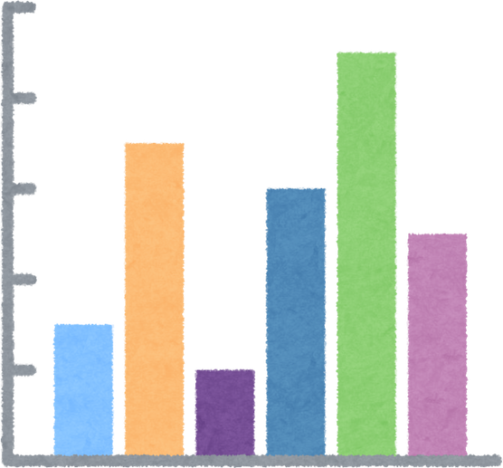
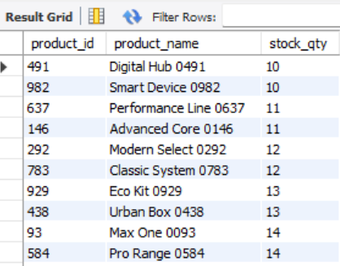
QUERY 9
Technique: WHERE clause • ORDER BY ASC
Filter: stock_qty < 20 threshold
Output: Products ranked by lowest stock first
LOW-STOCK PRODUCT ANALYSIS
SELECT product_id, product_name, category_id,
stock_qty
FROM products
WHERE stock_qty < 20
ORDER BY stock_qty ASC;
⚠ Business Insight
Flags inventory risks requiring immediate replenishment. Identifies products at risk of stockout to prevent lost sales.

Slide 18
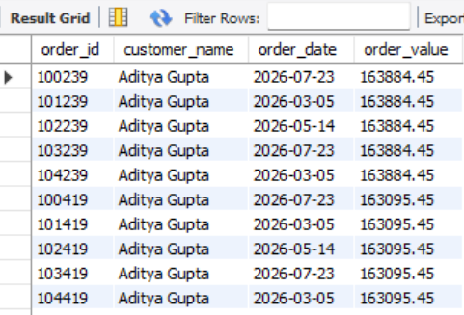
QUERY 10
Filtering orders with total value above ₹100,000 to identify premium transactions that require special attention and strategic focus.
HIGH-VALUE
ORDERS
SELECT o.order_id,
o.customer_id,
o.order_date,
SUM(oi.quantity *
oi.unit_price) AS
order_total
FROM orders o
JOIN order_items oi
ON o.order_id =
oi.order_id
GROUP BY
o.order_id
HAVING order_total
100000
ORDER BY
order_total DESC;
Business Insight: Highlights premium sales requiring special attention
Uses HAVING clause to filter aggregated order totals above threshold
Supports VIP order management and priority fulfillment strategies

Slide 19

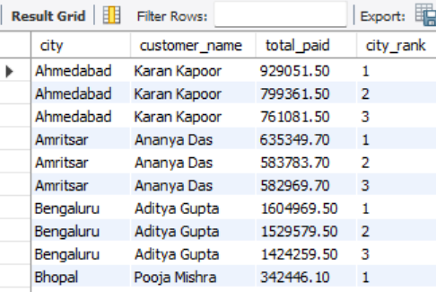
QUERY 11
SQL Technique: DENSE_RANK() Window Function — Ranks customers by total revenue within each city partition to surface local top performers.
TOP 3 CUSTOMERS
PER CITY
SELECT city, customer_name,
total_revenue,
DENSE_RANK() OVER (
PARTITION BY city
ORDER BY total_revenue DESC
) AS city_rank
FROM vw_customer_value
WHERE city_rank <= 3
ORDER BY city, city_rank;
Business Insight: Identifies the top 3 revenue-generating customers in each city, enabling targeted regional loyalty and marketing strategies for local leaders.

Slide 20
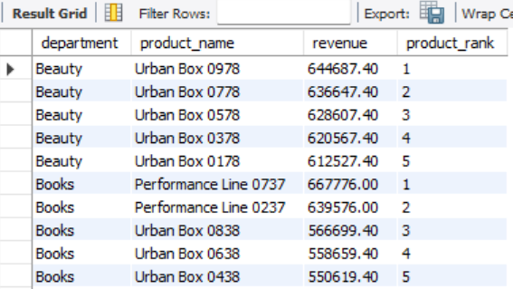
QUERY 12
TOP 5 PRODUCTS WITHIN EVERY DEPARTMENT
SELECT department, product_name, total_revenue,
product_rank
FROM (
SELECT
c.department,
p.product_name,
SUM(oi.quantity * oi.unit_price
* (1 - oi.discount_pct/100))
AS total_revenue,
ROW_NUMBER() OVER (
PARTITION BY c.department
ORDER BY SUM(oi.quantity
* oi.unit_price
* (1 - oi.discount_pct/100)) DESC
) AS product_rank
FROM order_items oi
JOIN products p
ON oi.product_id = p.product_id
JOIN categories c
ON p.category_id = c.category_id
GROUP BY c.department, p.product_name
) ranked
WHERE product_rank <= 5
ORDER BY department, product_rank;
Business Insight: Shows best-performing products per department to guide assortment planning and inventory prioritization.
• Window Function: ROW_NUMBER() PARTITION BY department
• Ranks products by revenue within each department segment

Slide 21

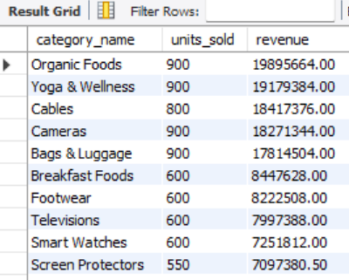
QUERY 13
SQL Technique: Common Table Expression (CTE) — WITH clause for modular, readable query structure
CATEGORY REVENUE
USING CTE
WITH category_sales AS (
SELECT
c.category_name,
c.department,
SUM(oi.quantity * oi.unit_price
* (1 - oi.discount_pct/100))
AS total_revenue,
COUNT(DISTINCT oi.order_id)
AS total_orders,
SUM(oi.quantity) AS units_sold
FROM order_items oi
JOIN products p
ON oi.product_id = p.product_id
JOIN categories c
ON p.category_id = c.category_id
GROUP BY
c.category_name, c.department
)
SELECT *
FROM category_sales
ORDER BY total_revenue DESC;
Technique: CTE (WITH clause) • JOIN across 3 tables • GROUP BY category & department • Modular query design

Slide 22
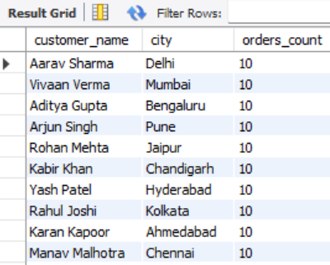
QUERY 14
Identifying loyal customers with 5+ orders using GROUP BY and HAVING
REPEAT CUSTOMER ANALYSIS
SELECT
c.customer_id,
c.customer_name,
c.email,
c.city,
COUNT(o.order_id) AS total_orders,
SUM(oi.quantity * oi.unit_price)
AS total_spent
FROM customers c
JOIN orders o
ON c.customer_id = o.customer_id
JOIN order_items oi
ON o.order_id = oi.order_id
GROUP BY
c.customer_id,
c.customer_name,
c.email,
c.city
HAVING COUNT(o.order_id) >= 5
ORDER BY total_orders DESC;
Business Insight: Highlights loyal customers who place 5 or more orders — critical for designing targeted loyalty programs, personalized retention campaigns, and long-term customer relationship strategies.

Slide 23
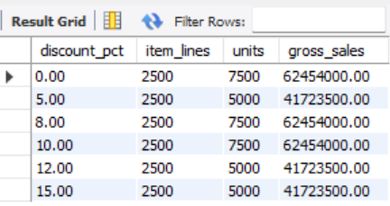
QUERY 15
Analyzes discount percentage tiers, item lines, units sold, and gross sales to assess the impact of discounts on overall revenue and volume.
DISCOUNT
ANALYSIS
SELECT
discount_pct,
COUNT(*) AS item_lines,
SUM(quantity) AS units_sold,
SUM(quantity * unit_price) AS gross_sales,
SUM(quantity * unit_price * (1 - discount_pct/100)) AS net_sales
FROM order_items
GROUP BY discount_pct
ORDER BY discount_pct ASC;
💡 Business Insight: Assesses impact of discounts on sales volume and revenue — helps optimize discount strategies for maximum profitability.

Slide 24
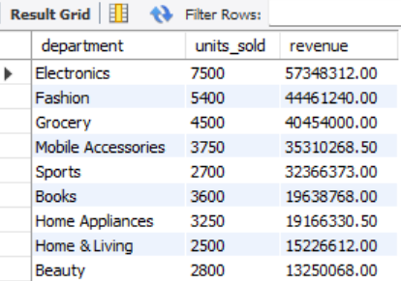
QUERY 16
Techniques: JOIN · GROUP BY · SUM() · COUNT() · ORDER BY
DEPARTMENT PERFORMANCE
SELECT p.department,
COUNT(oi.order_item_id) AS total_units_sold,
SUM(oi.quantity * oi.unit_price * (1 - oi.discount_pct/100)) AS total_revenue
FROM order_items oi
JOIN products pr ON oi.product_id = pr.product_id
JOIN categories p ON pr.category_id = p.category_id
GROUP BY p.department
ORDER BY total_revenue DESC;
Business Insight
Provides department-wise performance breakdown for strategic business focus and resource allocation.

Slide 25
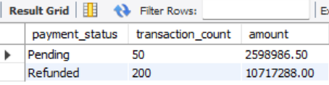
QUERY 17
SQL with GROUP BY on payment_status, COUNT(*) and SUM(amount) to monitor pending and refunded payment volumes and cash flow impact.
PENDING &
REFUNDED
PAYMENTS
SELECT payment_status,
COUNT(*) AS total_txns,
SUM(amount) AS total_amount
FROM payments
GROUP BY payment_status
ORDER BY total_amount DESC;
⚠ Business Insight: Monitors payment issues impacting cash flow
⚠ Highlights pending and refunded payment statuses
⚠ Supports financial risk and reconciliation tracking

Slide 26

Analysis of 5,000 orders, 500 customers, and 1,000 products reveals clear patterns in revenue distribution, customer behavior, and inventory health — providing a strong foundation for data-driven decisions.
Revenue is heavily concentrated in a small number of high-performing product categories. Customer lifetime value analysis clearly identifies high-value segments worth prioritizing for retention and personalized marketing efforts.
Monthly revenue trends expose strong seasonality patterns, enabling better forecasting and campaign planning throughout the year.
Payment behavior differs significantly across methods, revealing opportunities to optimize checkout flows and reduce refund and pending payment rates.
Revenue concentrated in few high-performing categories
Customer lifetime value identifies high-value segments
Inventory analysis flags products needing restock
KEY BUSINESS
INSIGHTS

Slide 27

BUSINESS
RECOMMENDATIONS
  Focus Marketing
  Concentrate campaigns on high-revenue categories and top-performing products identified through revenue analysis.
  Retain High-Value Customers
  Deploy loyalty programs targeting customers with highest lifetime value and repeat order frequency.
  Replenish Low-Stock Products
  Prioritize restocking of products flagged by inventory analysis to prevent lost sales opportunities.
  Optimize Discount Strategies
  Review discount tiers using discount impact analysis to protect margins while sustaining volume.
  Reduce Payment & Refund Issues — monitor pending and refunded payments to protect cash flow
  Align regional marketing with city-level revenue data for targeted outreach
  Use monthly trend insights to plan seasonal promotions effectively
These recommendations are derived directly from query outputs across sales, customer, product, and payment analyses — enabling data-driven decisions at every business level.
Based on SQL-driven analysis of the e-commerce dataset, the following strategic recommendations are proposed to improve revenue, customer retention, inventory health, and payment performance.

Slide 28

CORE SKILLS
SQL ●●●●●
Data Modeling ●●●●○
Data Analysis ●●●●●
Business Intelligence ●●●●○
Problem Solving ●●●●●
TECHNIQUES USED
MySQL & Joins
CTE & Subqueries
Window Functions
Aggregation & HAVING
Analytical Views
A comprehensive showcase of data analyst skills applied to a real-world e-commerce database — from raw SQL to actionable business insights.
WHAT THIS PROJECT DEMONSTRATES
MySQL
Joins
CTE
Window Functions
Views
Aggregation
Every query in this project was designed to answer a real business question — turning structured data into strategic decisions.

Slide 29

E-Commerce Sales & Customer Analytics
MySQL Data Analyst Portfolio Project
A structured, end-to-end analytical workflow — from building the relational database to delivering actionable business decisions using SQL and data modeling.
FROM RAW
DATA TO
INSIGHT
PROCESS FLOW
① DATABASE
② DATA MODEL
③ SQL QUERIES
④ ANALYSIS
⑤ INSIGHTS
⑥ BUSINESS DECISIONS
Each step builds on the last — raw data is structured, queried, analyzed, and transformed into clear, actionable insights that drive smarter business decisions.

Slide 30

CONCLUSION
This project demonstrates how SQL can transform relational e-commerce data into actionable business insights.
From designing a normalized database to writing advanced analytical queries, every step was driven by real business questions and measurable outcomes.
DATA
Raw relational tables structured for analysis — customers, orders, products, payments.
ANALYSIS
SQL queries, CTEs, window functions, and views uncovering patterns and performance.
DECISION → Insights that drive smarter strategy, retention, and growth.

Slide 31

E-Commerce Analytics
MySQL Portfolio
THANK YOU
QUESTIONS &
DISCUSSION
Sahil Kanojia
Aspiring Data Analyst
This project demonstrates how SQL can transform relational e-commerce data into actionable business insights.
Sahil Kanojia
Aspiring Data Analyst

